Slide 1
So, Now what, Lord?

Slide 2
Retreat
Stephen
Ministers
May 6, 2006

Slide 3
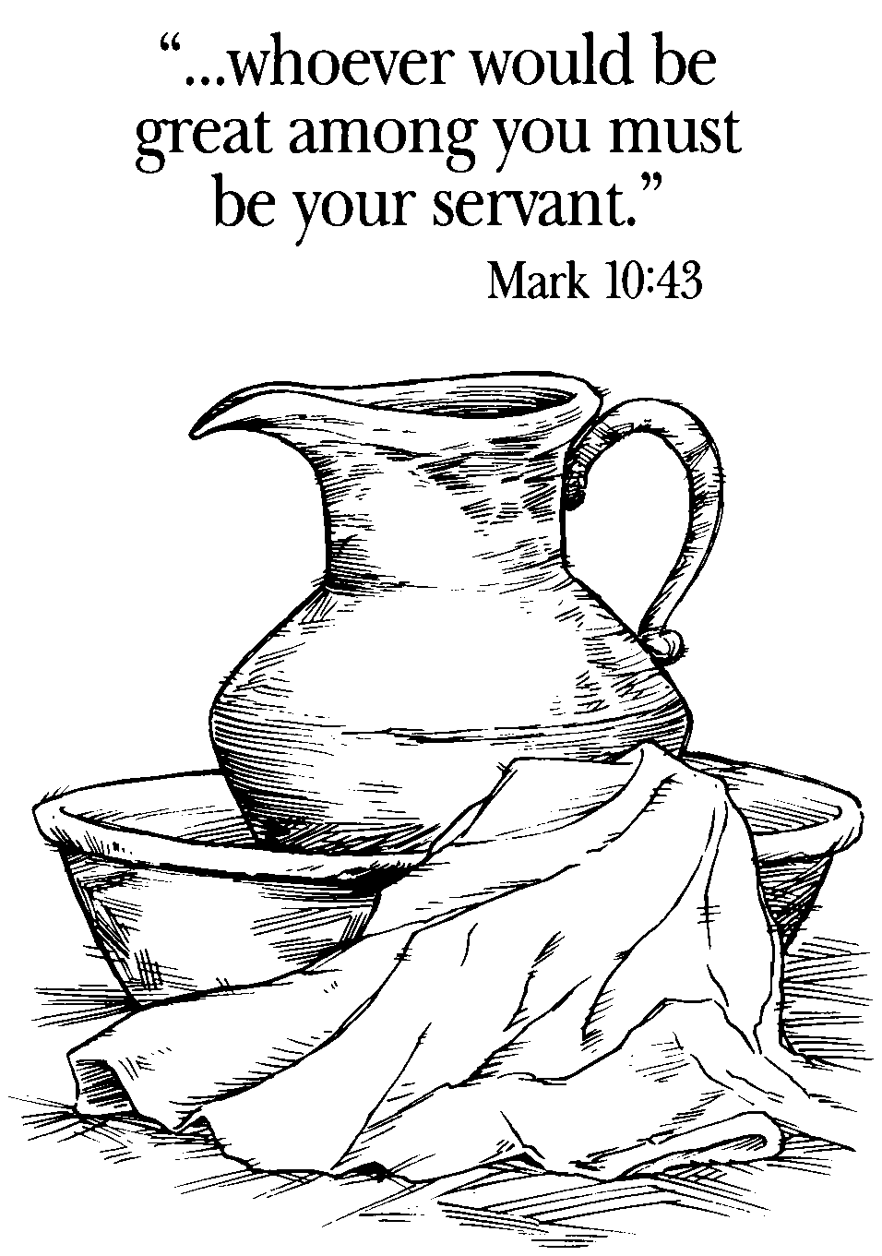

Slide 4
Stephen Ministers
Are
Of good report and
Full of the Holy Ghost and wisdom
Acts 6.3-5
And
Called to Serve

Slide 5
St. Christopher’s Episcopal Church
The Reverend Fr. Paul Moore, Rector
May 6, 2006

Slide 6
We want to be called of God; we want that holy calling upon our lives.
  But do we want the blessing
  Because with the blessing, comes the breaking
  Before we can be used

Slide 7
The breaking holds in it grief.
  Grief because we will part and go away from the Master – alone – but not on our own.
  We will not be able to touch Jesus in the flesh as we encounter the hurts, the disappointments, the feeling of being abandoned . . .
  but know of a surety, He is here – Alleluia!

Slide 8
Remember that the Father only once said, “This is my Beloved Son, of whom I am well pleased.”
Remember Jesus said, My God, My God, why hast Thou forsaken Me.
  The Father did not continue to give the Son encouragement as things got worse. He hung on the cross alone.
  Even the disciples were not near the cross.
  God the Father could not look upon sin.
Even Jesus had feelings and was able to speak them forth so that we could listen in to His Words.

Slide 9
The disciples while here on earth walked with Jesus
  Trying to learn? No, there was something in Jesus that drew them to Him.
  They wanted to just be in His presence.
  Loving Him with all their heart?
  No, the love grew little by little.
  Oh, there was something there that drew them, that caused them to leave all and follow Him.

Slide 10
Learning as they walked with Him? Yes.
  Remember this was not a mentoring process.
  This was a love process that caused them to give up all and follow Him at all costs.
  They gave up family.
  They gave up their work – some were more paying type jobs and others paid a lot less.
  Jesus drew from different classes – if you will.

Slide 11
This was a love that could not turn back – no matter how hard it got.
  Yes, there was one who did.
  There was another who tried, but his love for Jesus was too great to let go of Jesus.

Slide 12
John 21.15-19 – the commission – to go back down to the rubble, the cross.
Peter, you will die upon a cross.
You will stand firm.
So, to you I say, Shepherd my lambs. (Use John 21.15-19 at end)

Slide 13
You have known the steps of discipleship as you have already been walking that way – the via dolorosa.
1. Responding to the Master’s invitation: Follow me

Slide 14
2. Then comes the course of practical training, the walk with the Master moment by moment in the heart and literally with the feet and mind.
  This call was a call to respond to the Great Commission: “Go, preach, saying, the kingdom of heaven is at hand.”
  It was the call of Isaiah 61.1-3

Slide 15
  Your call has been here at home, but first it is after you have received the power of the Holy Ghost, that the Holy Ghost is come upon you, Acts 1.8

Slide 16
  However, some of you will receive a call to go a little further out – or maybe a long way out of the concentric circle.
  Some of you have already been on the long journey and have now come back home to minister.

Slide 17
  You see, this is a prophetic ministry. A prophetic ministry is speaking forth the Truth of the Lord God in accordance with His Word. It is “Guard [ing] the good treasure entrusted to you, with the help of the Holy Ghost living in us [you]” (II Timothy 1.14).

Slide 18
  It is as Paul said to young Timothy, “Do not neglect the gift that is in you, which was given to you through prophecy with the laying on of hands by the council of elders” (I Timothy 4.14).

Slide 19
3. Then come the severing of ties – physical ties that seems to hurt the most, the going forth in the Name of the Lord.

Slide 20
  This is when the fiery darts of hell may come. They may come in ways that seem so subtle, and cause you to stumble before you realize it, making you feel so sinful, so foolish . . .
    This is when you realize how much you need the Lord you God – so this is not all bad, if we repent and turn back to the Lord.
    This time of renewal can be most rewarding. I must admit it is not how I like to learn.

Slide 21
  Or this is when the attacks come straight forward and pierce the heart, causing you to hesitate in your walk with the Lord, perhaps.
    But this is when the Lord lifts the fallen, pulls you into His bosom, to encourage you.
    This is when the Lord reminds you that He is counting on you to go forth with His love and wisdom to minister the Balm of Gilead to a hurting world.

Slide 22
  Or the enemy, called Satan, says to the Lord that He is going to sift you. He is out for your very life.
  He may come at you with a situation in your home, at work, - yes, even at church.

Slide 23
John 16.33.b “. . . In the world you face persecution. But take courage; I have conquered the world!”
II Timothy 3.12, “Indeed, all who want to live a godly life in Christ Jesus will be persecuted.”
Then comes the words from the Master reminding you – I have called you by your name, even before you were born. You are mine (Isaiah 43.1-28).

Slide 24
They were called that they might be sent – sent to preach –
To the barbarians of Lycaonia
To the Celts of Salatra
To the Diana worshippers of Ephesus
To the philosophers of Athens,
To the legionnaires of Rome.

Slide 25
Called –
To be stoned at Lystra,
To be scourged at Philippi,
To be imprisoned at Caesarea,
To die without the gate.

Slide 26
Were they chosen just to be with Christ, and enjoy His sweet and blessed fellowship? No chosen –
  That they might be sent;
  Saved that they might save others;
  Blessed that they might become a blessings;
  Redeemed that they might preach the Gospel of Redemption

Slide 27
Chosen that they might hear Christ’s name before governors
and kings and before the children of Israel, and suffer many things for that Name’s sake

Slide 28
When Jesus finds you,
  “Tell others the story.”[1]
[1] Lockyer, All the Apostles of the Bible, p 20.

Slide 29
Then comes the words from John 15.1-17.
  Let’s go to John 21.15-19
  Share the Scripture and going back to John 18.15-18, 25-27
  Then John 21.15-19 – go through it verse by verse
  Then end with brief of Peter in Quo Vadis

Slide 30
What more is there to give?
  I have a picture in my house that is a beautiful rock formation perhaps in Colorado or Arizona.
  It is a rock formation that is oval through which you see other beautiful rock formations
  The Heading?
    When a door closes, God opens a window.

